Slide 1
Officer Development Program
Transfer of Command

Slide 2
Transfer of Command
Transfer of command from one incident commander to the next is something that may take place on the fire ground.
When doing so, this transfer should improve the quality of command or at least maintain the command structure that is in place.
A Chief officer that arrives first on scene or arrives at the same time as the first arriving engine/truck should take command.

Slide 3
Transfer of Command
In the absence of a first arriving Chief officer, the first arriving unit will establish command.
Once a Chief officer arrives on a working/ complex incident, there should be either a face-to-face or radio communication indicating if there is a need to transfer command.

Slide 4
Transfer of Command
Situations that would indicate a need for a transfer of command could include the following:
Taking initial command of an outside agency’s event.
The need for the initial commander to go hands on at the incident.
The incident requires a large amount of resources to stabilize the incident.

Slide 5
Transfer of Command
Situations that would indicate a need for a transfer of command could include the following (continued):
The incident will go on for more than one work period.
The incident will grow beyond the boundaries or capabilities of the IC.
The incident will be managed by a different authority, such as moving the incident to the State or Federal level.

Slide 6
Procedure for Transfer of Command
First arriving officer assumes command (IC) and provides size up.
Chief officer announces to dispatch arrival on scene.
Chief Officer, based on the event, can do a face-to-face with the IC or communicates via radio that they have arrived and asks for an update. “Command from Battalion I, I have arrived, give me an overview of what you have”

Slide 7
Procedure for Transfer of Command
The initial IC should communicate what they have, who they have assigned and what they plan to do moving forward (objectives). “Battalion I, I have a single-family dwelling with smoke showing from the Charlie side of the building. I have ME-1 on fire attack, ME-5 on water supply, T-5 on ventilation and E-4 as RIC. We are offensive at this time and we are trying to get a primary all clear as well as find the fire.”

Slide 8
Procedure for Transfer of Command
Battalion I confirms what was stated and announces to the initial IC, “ Battalion I copies, I will assume University Command”
Battalion I then announces to dispatch that they are assuming command. “ Dispatch, Battalion I will be assuming University Command.”
Battalion I will also assign the initial IC to a task such as joining their crew.

Slide 9
Procedure for Transfer of Command
Dispatch will acknowledge the change in command. “Dispatch copies, Battalion I has University Command.”
Subsequent changes in command; where the B/C transfers to another person should be done in like manor. “ Fire from University Command, I will be transferring command to the Captain on ME-1.”

Slide 10
Procedure for Transfer of Command
Dispatch will acknowledge the change in command. “Dispatch copies, Battalion I has University Command.”
Subsequent changes in command; where the B/C transfers to another person should be done in like manor. “ Fire from University Command, I will be transferring command to the Captain on ME-1.”

Slide 11
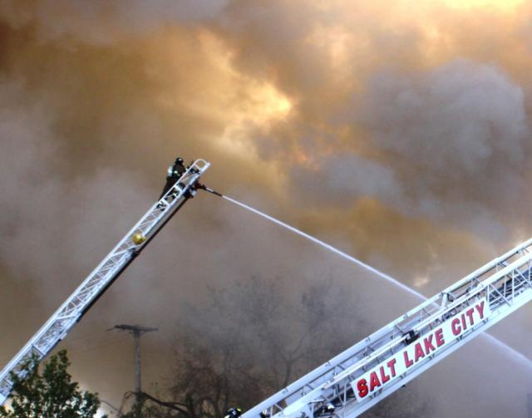
The transfer of command must be done in a way as to not confuse those working on the fire ground and to ensure the continuity of what is taking place is maintained.

Slide 12
Procedure for Transfer of Command
The following is a recorded example of a transfer of command.
Remember- this is only an example.
As long as the IC and the one command is being transferred to meet the above criteria, that transfer of command is complete.

